Slide 1
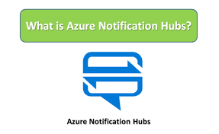
What is Azure Notification Hubs?
Azure Notification Hubs is a cloud-based service that helps you send notifications to mobile devices, such as iOS, Android, and Windows devices. It's a scalable and secure way to send push notifications to your app users.

Slide 2
Why Use Azure Notification Hubs?
Scalability: Notification Hubs can handle a large volume of notifications, making it perfect for apps with millions of users.
Security: Azure Notification Hubs provides secure authentication and encryption to ensure that your notifications are delivered safely.

Slide 3
Multi-platform support: You can send notifications to multiple platforms, including iOS, Android, and Windows, from a single hub.
Easy integration: Notification Hubs integrates easily with your existing app and backend infrastructure

Slide 4
Key Concepts
Notification Hub: A notification hub is a container that holds your notification settings and credentials.
Registration: A registration is a unique identifier for a device that wants to receive notifications.
Tags: Tags are used to categorize registrations and target specific groups of devices.
Notifications: Notifications are the actual messages sent to devices.

Slide 5
How Does it Work?
Device registration: A device (e.g., a mobile phone) registers with the notification hub, providing a unique identifier and platform-specific credentials.
Tagging: T3he device is assigned one or more tags, which help you target specific groups of devices
Notification creation: You create a notification in your app backend, specifying the target tags and notification content.

Slide 6
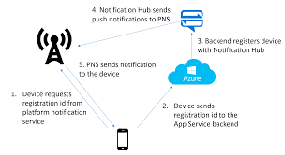

Slide 7
Notification sending: The notification is sent to the notification hub, which then forwards it to the targeted devices.
Device receives notification: The device receives the notification and displays it to the user.

Slide 8
Features
Scheduled notifications: Send notifications at a scheduled time or interval.
Rich notifications: Send notifications with rich content, such as images, videos, or custom layouts.
Personalization: Use templates and placeholders to personalize notifications for individual users.

Slide 9
Analytics: Track notification delivery, opens, and clicks to measure the effectiveness of your notifications.
Security: Use authentication and encryption to ensure secure notification delivery.

Slide 10
Pricing
Azure Notification Hubs offers a free tier, as well as several paid tiers, depending on the number of notifications you need to send. The free tier includes:
1 million notifications per month
100 active devices
10 tags

Slide 11
Common Use Cases
News and media apps: Send breaking news alerts or personalized content to users.
Gaming apps: Send in-game notifications, such as score updates or special offers.
E-commerce apps: Send personalized promotions, order updates, or abandoned cart reminders.
Health and fitness apps: Send workout reminders, fitness goals, or health tips.

Slide 12
Getting Started
To get started with Azure Notification Hubs, follow these steps:
Create an Azure account: Sign up for a free Azure account if you haven't already.
Create a notification hub: Go to the Azure portal and create a new notification hub.

Slide 13
Install the SDK: Install the Azure Notification Hubs SDK for your preferred platform (e.g., iOS, Android, or Windows).
Register devices: Register devices with the notification hub using the SDK.
Send notifications: Start sending notifications to your registered devices!

